Slide 1
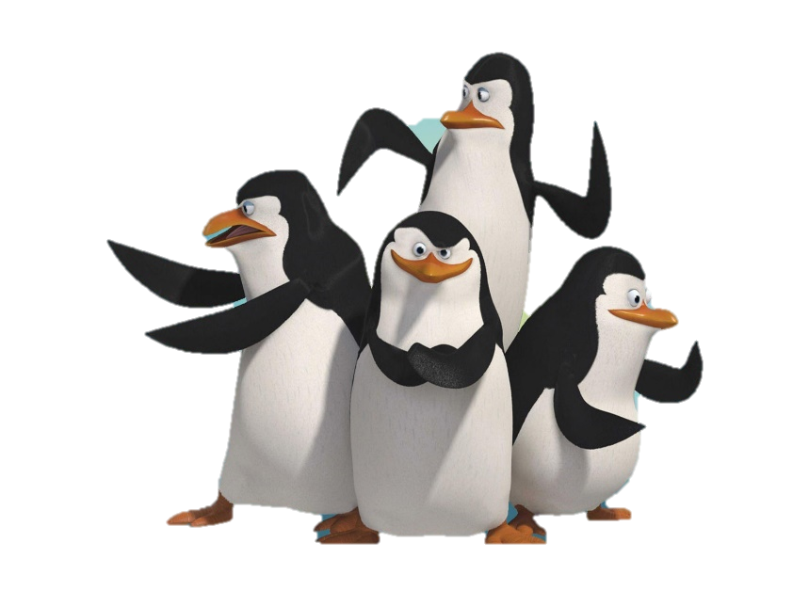
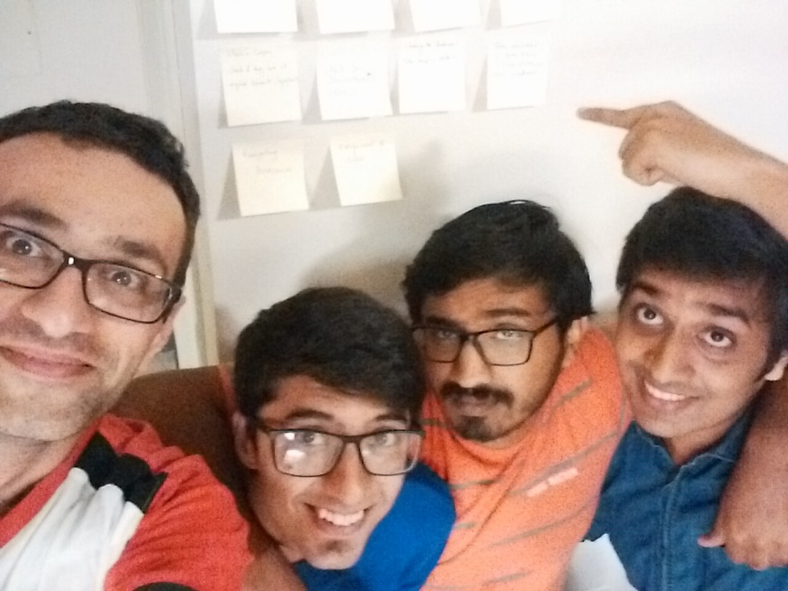
Software Development Class - IST 303 Professor Terry Ryan Gila Breath Camp 2nd Milestone
Team #Penguins:
Jemin Gohil (aka Rico)
Karthik Manjunath (aka Kowalski)
Rohan Sawant (aka Skipper)
Soheil Bouzari (aka Private)

Slide 2
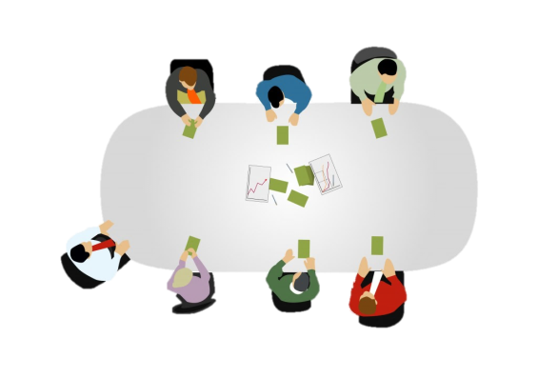

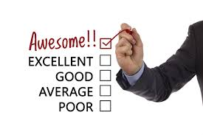


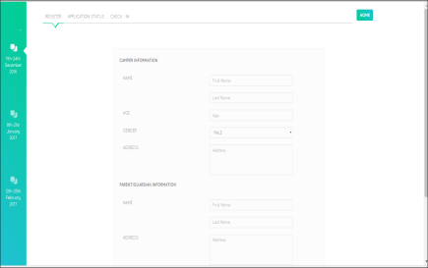
Agenda
Reviews & Take-away
from Milestone 1.0
Project Planning
Activities in
Milestone 2.0
Testing
Automated Tools
Demo

Slide 3
Reviews and Takeaway from Milestone 1
• I agree with your classmates that most of what you did was quite good. In particular, you did a strong job of using tools for development and testing.
• I liked your analysis/discussion of commit history.
• I liked your analysis/discussion of refactoring.
• Excellent analysis/discussion of testing.
• The biggest weakness was probably your explanation of requirements gathering. I know that you did this well, but you didn’t explain it well.
• Next biggest weakness was the “domination” of the presentation by Rohan. I attribute this to enthusiasm, but to the class it seemed to be indicative that the other members of the group weren’t as responsible for the accomplishments. I know this is not so, but do a better job with sharing next time.

Slide 4
Summary from Milestone 1
• TEST DRIVEN DEVELOPMENT
1. Unit testing (Wrote small test. But didn’t automate much) – (python packages – unittest)
2. Functional testing (Shown for Registration. Automated fully) – (python packages – pytest)
• Deviated a lot from planned track but due to support from Customer made it up at the end
• Used HTML and javascript as front end and flat files with python Django framework
• 4 user stories – Choosing date, Registration, Application status, Check-In
• 3 iterations (Weekly iterations)

Slide 5
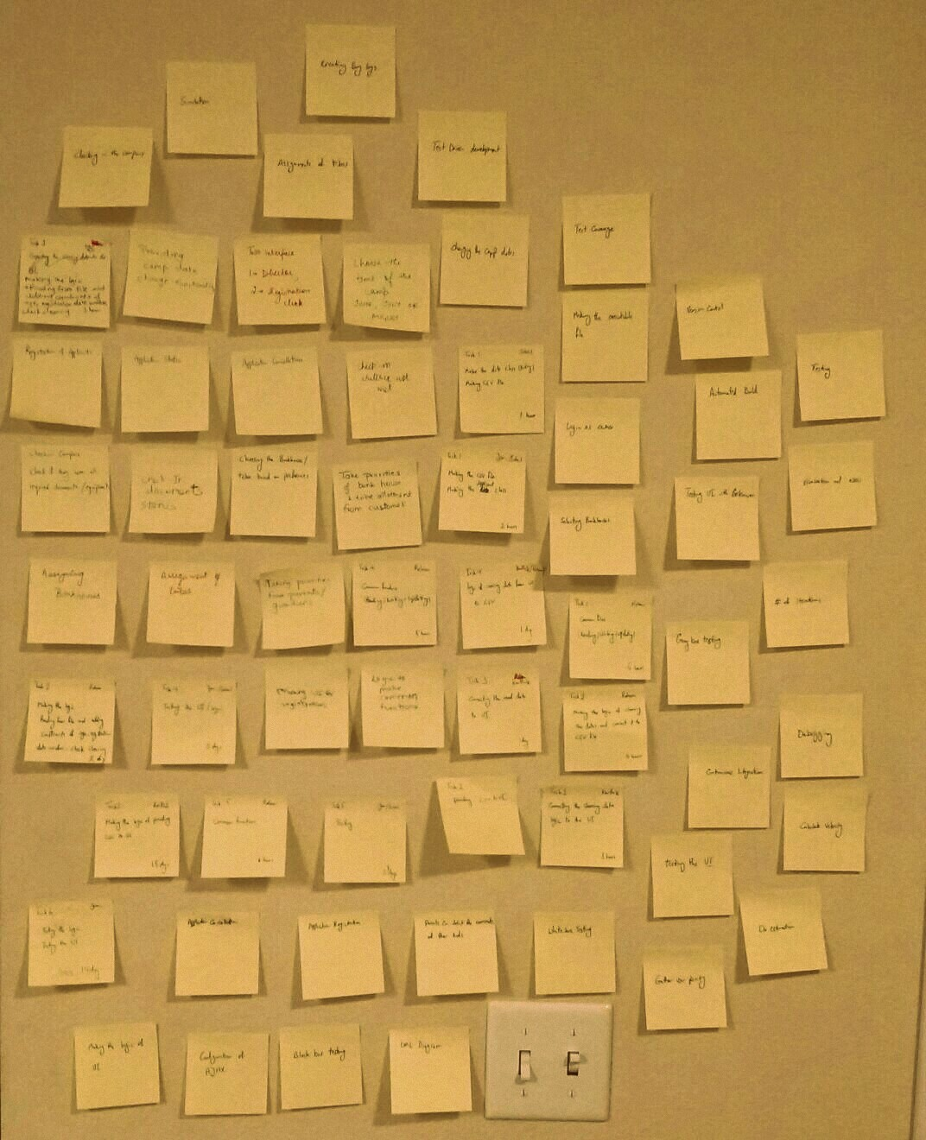
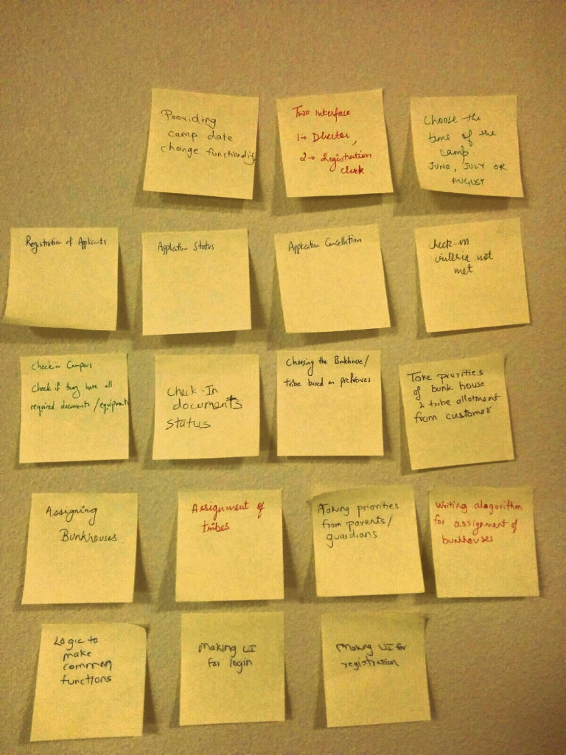
1
Project Planning
Gathering Requirement
Brainstorming:
Weekly Talks with professor
Had total of 3 + 5 weekly iterations with professor directly
2. Blue-skying:
Old traditional Way of using sticky notes. Did a lot this time to cover all possible scenarios

Slide 6

1
Project Planning
Gathering Requirement
3. Role-Playing:
This was done majorly and was very helpful. Asked lot of colleagues and friends to provide us with suggestions. Some would be referred by Sohiel.

Slide 7

1
Project Planning
Gathering Requirement
4. Observation:
a. 1st Milestone – Other task
like printing of notices is something we missed out and this is something that we got by observing other project groups
b. Online websites
http://www.activecamps.com/

Slide 8
1
Project Planning (Planning Poker)
Prioritizations | User Stories | Rohan | Jemin | Karthik | Soheil | Average
10 | Priorities from Guardian | 9.00 | 4.00 | 6.00 | 5.00 | 6.00
10 | Assignment of Bunk Houses | 8.00 | 9.00 | 10.00 | 12.00 | 10.00
10 | Assignment of Tribes | 5.00 | 10.00 | 12.00 | 14.00 | 11.00
10 | Printing of acceptance notice | 7.00 | 6.00 | 8.00 | 8.00 | 8.00
20 | Application Cancellation | 5.00 | 3.00 | 9.00 | 8.00 | 7.00
20 | Refund | 7.00 | 9.00 | 8.00 | 9.00 | 9.00
25 | Printing of non-fulfillment of request | 4.00 | 4.00 | 5.00 | 7.00 | 5.00
25 | Log In | 3.00 | 3.00 | 5.00 | 5.00 | 4.00
 | Total Sum | 39.00 | 44.00 | 57.00 | 63.00 | 51.00
Prioritization given by customer
3rd Milestone
Notes:
We did planning poker when each one provided with estimated time in days for each user story. Except for login and prin

Slide 9
1
Project Planning
(Estimation of project schedule)
Milestone 2.0 | Calculation
Start Day | 10/21/2016
End Day | 12/5/2016
Number of days before release (Calendar days) | 46.00
Estimated Days of Work | 60.00
Number of people in Team | 4.00
Number of workdays left (Only Week Days) | 32.00
Holidays by Developers | 0.00
Number of workdays left (Excluding Holidays) | 32.00
Velocity | 0.40
Available Work Days | 12.80
Amount of work team is likely to complete before due date | 51.00
Days of work that could be deferred | 9.00
More working days (1st Milestone – 31)
More work days left (1st Milestone – 22)
Same Velocity
3rd Milestone

Slide 10
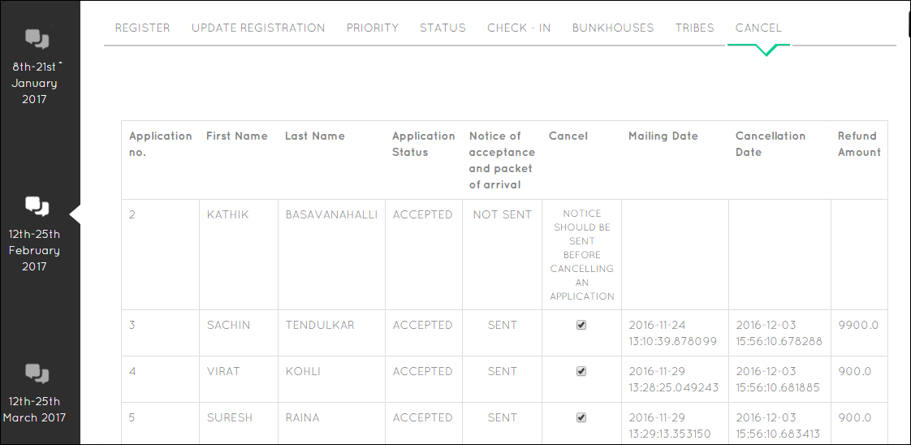
2
2nd Milestone Activities (Cancellation and Refund)
2nd Milestone
Refund
Notes:
We added a new user story of cancellation only for accepted applicants. Cancellation could be done only if the notice is sent and that’s the option we have provided. Here we have also incorporated the refund amount user story.

Slide 11
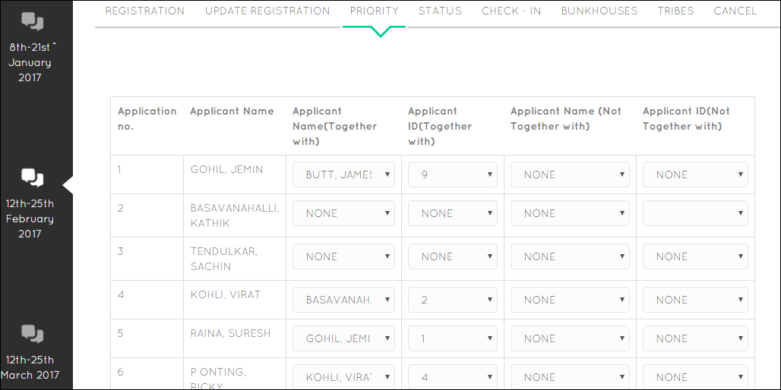
2
2nd Milestone Activities (Priorities)
2nd Milestone
Notes:
This is “taking priority” user story. Here we collect information whether the applicant wants to stay together or not together with another applicant.
This is a part of 2nd milestone

Slide 12
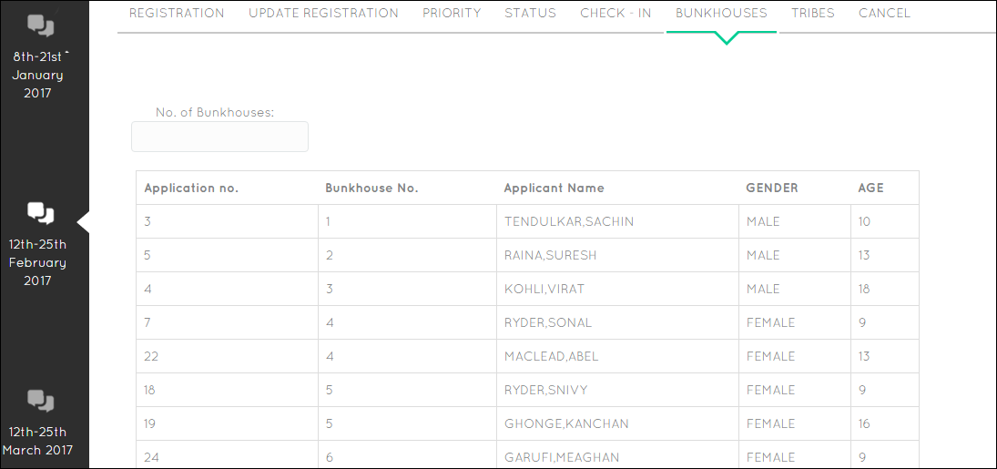
2
2nd Milestone Activities (Bunkhouses)
2nd Milestone
Notes:
Then we come across the user story of assigning applicants to Bunkhouses. Here we could see the number of bunkhouses option which shows that number of bunkhouses could be changed dynamically

Slide 13
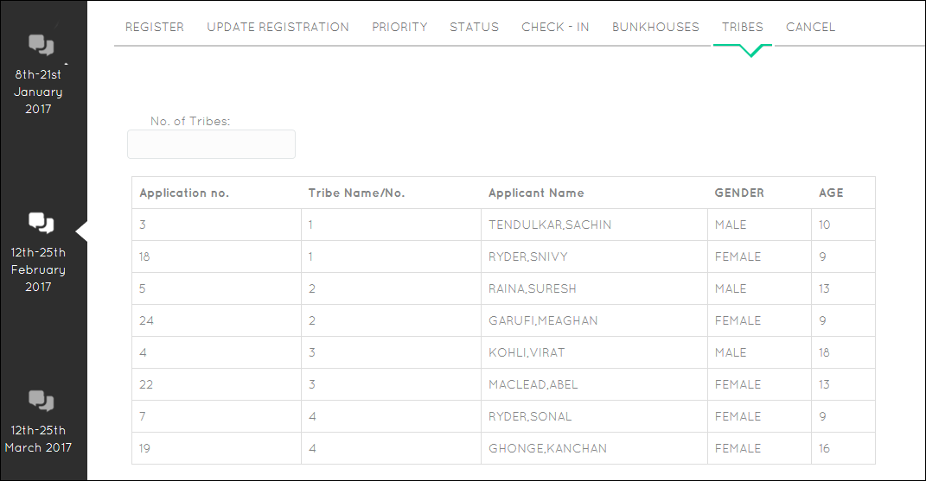
2
2nd Milestone Activities (Tribes)
2nd Milestone
Notes:
Then we come across the user story of assigning applicants to Bunkhouses

Slide 14
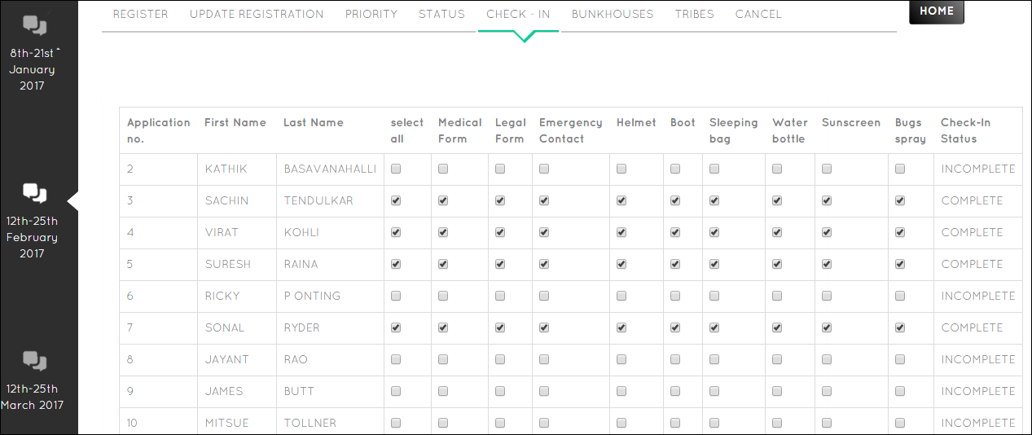
2
2nd Milestone Activities (Check-In)
IMPROVEMENT made in 2nd Milestone after recommendation after Role-play with colleague
1st Milestone
Notes:
Here we shows the check-in for accepted applicants only which was the part of the 1st Milestone
Here we added Select all to increase user experience which was recommendation given by one of our colleagues after doing role play which again referred by Rohan in gathering requirement

Slide 15
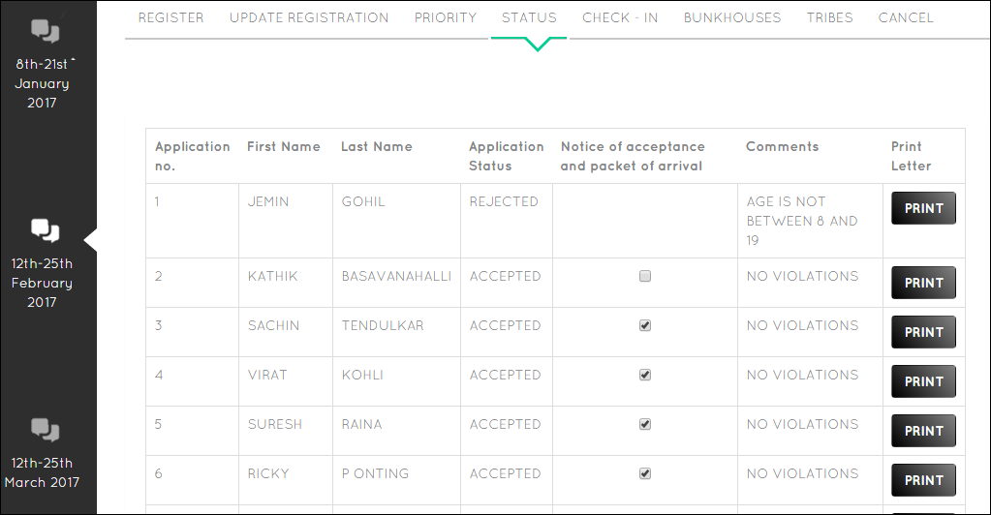
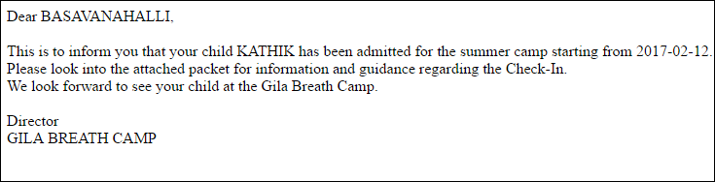
2
2nd Milestone Activities (Printing)
2nd Milestone
Printing
(New User Story derived by observing other groups)
1st Milestone
Notes:
After registration we show the status of the of the applicant whether it is accepted or rejected along with comments if rejected.
This was part of 1st milestone.
Here we have added a new story called as printing which is a part of 2nd milestone.
This was derived by observing other groups as explained by Rohan here

Slide 16
2
2nd Milestone Activities (Task division)
User Story: Priorities from Guardian
Task No | Task | Developer | Time
1 | Making the Priority class entity | Rohan | 2 hours
 | Updating the CSV file
2 | Making the logic for applying priorities | Rohan | 6 hours
 | Connecting it to the CSV File
3 | Connecting the priority logic to the UI | Karthik | 1 day
4 | Testing the logic | Jemin & | 2 days
 | Testing the UI | Soheil
User Story: Assignment to tribes
Task No. | Task | Developer | Time
1 | Making the Tribes class entity | Soheil | 3 hours
 | Updating the CSV file
2 | Making the logic for assigning Tribes | Rohan | 9 hours
 | Connecting it to the CSV File
3 | Connecting the Tribes logic to the UI | Karthik | 2.5 days
4 | Testing the logic | Jemin | 7 days
 | Testing the UI
User Story: Printing of Acceptance or Rejection Notices
Task No. | Task | Developer | Time
1 | Making the Printing of notices class entity | Soheil | 4 hours
2 | Making the logic for printing of notices | Jemin | 1 day
 | Connecting it to the CSV File
3 | Connecting the printing logic to the UI | Karthik | 1.5 day
4 | Testing the logic | Rohan | 4 days
 | Testing the UI
We divided our user stories into tasks. We followed the same design as we did in 1st Milestone. Making a class file for User story and always Refactoring. But since we followed Object Oriented Design refactoring was not required much except for 2 cases.
User Story: Assignment to Bunkhouses
Task No | Task | Developer | Time
1 | Making the Bunkhouses class entity | Soheil | 3 hours
 | Updating the CSV file
2 | Making the logic for assigning bunkhouses | Rohan | 9 hours
 | Connecting it to the CSV File
3 | Connecting the bunkhouse logic to the UI | Karthik | 2.5 days
4 | Testing the logic | Jemin | 5 days
 | Testing the UI

Slide 17
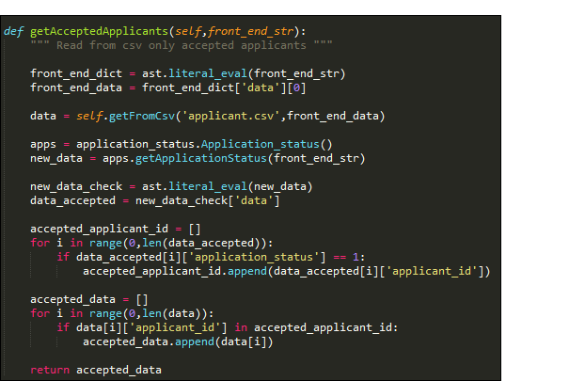
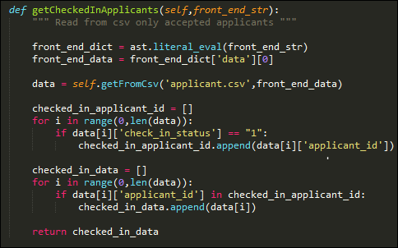
2
2nd Milestone Activities (Design –
Refactoring: SRP & DRY)
Function to get Accepted applicants only which was in Check-In User story
Function to get Check-In applicants which was to be used for bunkhouses and tribes user story
Moved these both functions to common functions as a part of refactoring

Slide 18
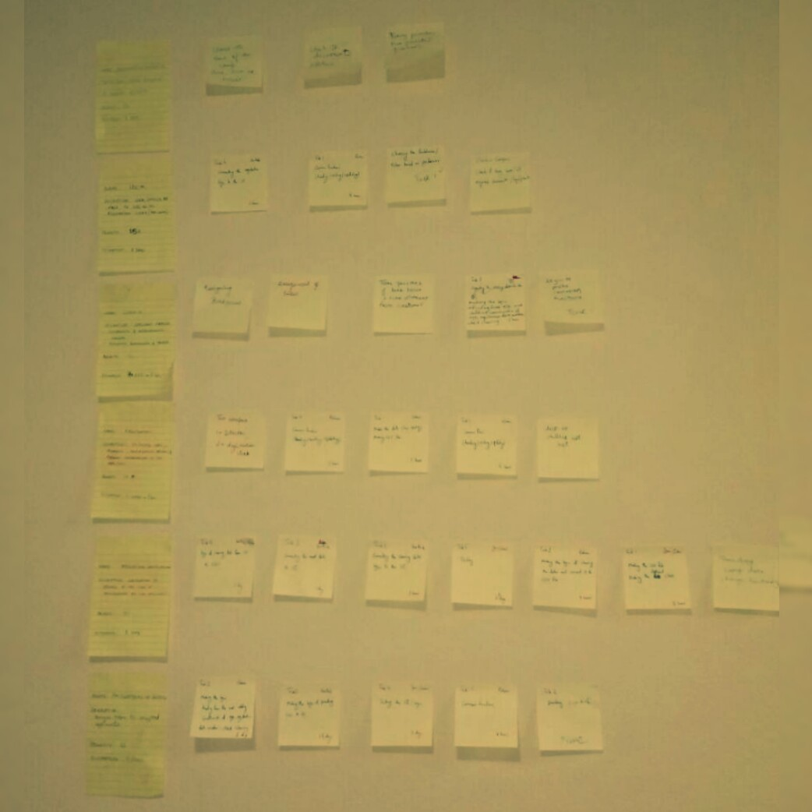
2
2nd Milestone Activities (Big Board)
This time also we used traditional sticky notes for the Big Board. This is a snapshot of our completed Big Board

Slide 19
2
2nd Milestone Activities –
Burn Down Chart (Iteration 8)
We were on track NEARLY for the whole of 2nd Milestone. This is due to the learning from 1st Milestone

Slide 20

3
Testing - Black-box testing (Selenium)
Tests the code from User Interface
We could test bugs from user’s perspective
We automated the usage of selenium

Slide 21
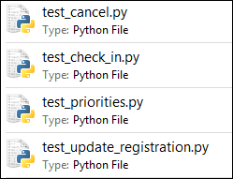
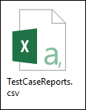
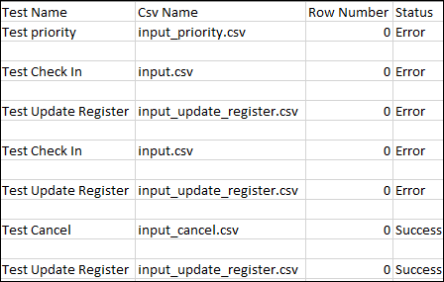
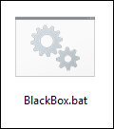

3
Testing - Black-box testing (Selenium Automation)

Slide 22
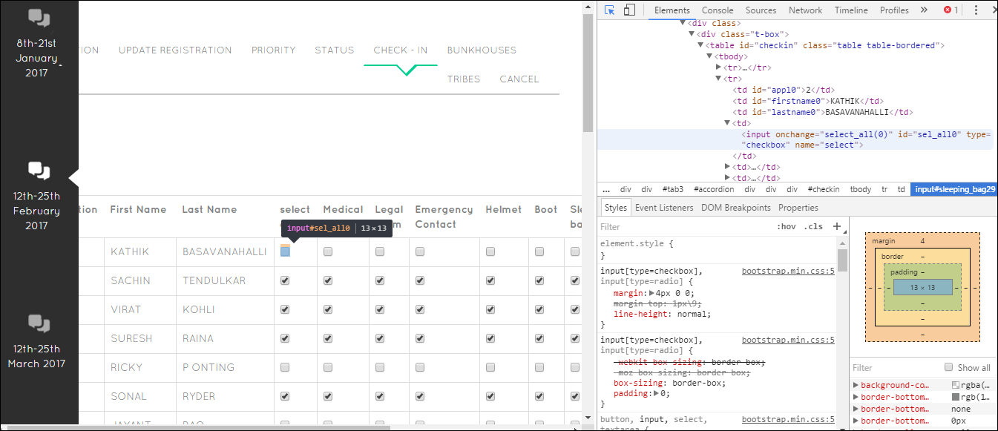
Testing - Black-box testing
(Selenium Explanation)
3
This is the id behind checkbox i.e. “sel_all0”. This is passed to chromedriver and selenium functions according to requirement

Slide 23
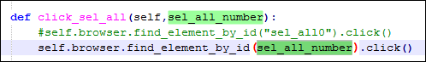
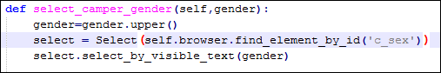
Testing - Black-box testing
(Selenium Explanation)
3
Define a function to click on select all check box that takes id “sel_all0”.
Define a function to click on select all check box that takes id “sel_all0”.
This is provided by chromedriver.exe
This is provided by selenium
We use selenium when we want to perform actions

Slide 24
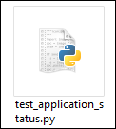
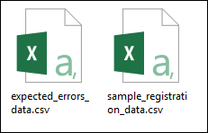
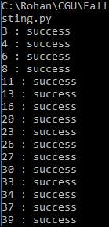
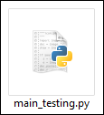
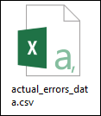
3
Testing – Grey Box Testing
unittest
pytest
Performs operations on Sample data and create
Sample Data Files:
Data for user story
Expected result

Slide 25
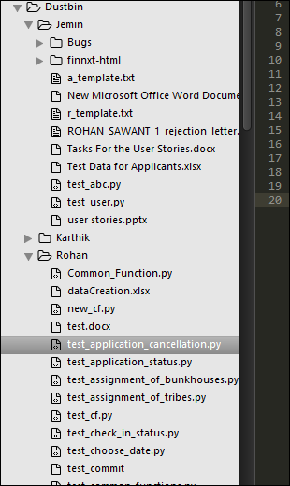
3
Testing - White-box testing
This was done manually at the start of project
We had a concept of “Dustbin” where each developer would test the code of other developer by making test cases
Here we mostly used unittest, json, ast packages

Slide 26
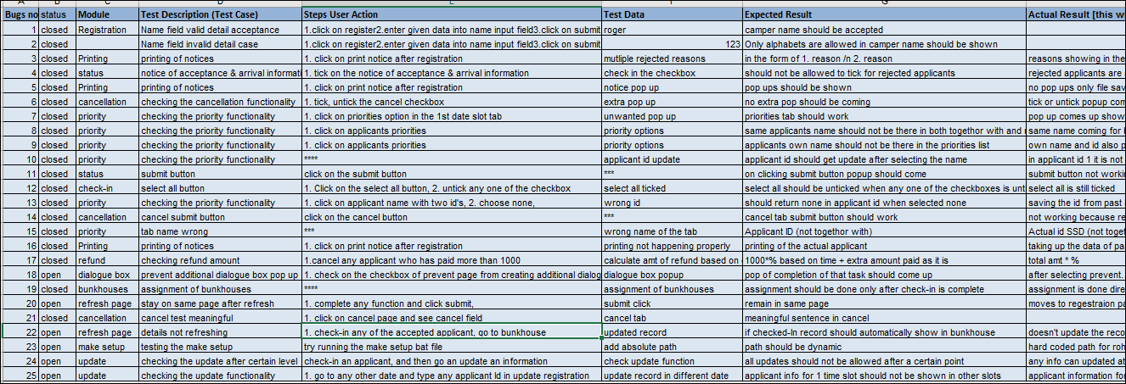
3
Testing - Bugs
As Pilone and Miles stated - Every time you encounter a bug you should enter those values in the test case after fixing the bug and we did the same. This helped us to test the bugs each time we encountered a new bug just to see whether it effected earlier bugs or not.

Slide 27


4
Automated Tools: Version Control
As GitHub is easily accessible to all and we wanted a more SECURE VERSION CONTROL tool for our code, so we shifted from GitHub to BitBucket.
Link: https://bitbucket.org/Rohan9969/software_development_cgu/overview

Slide 28
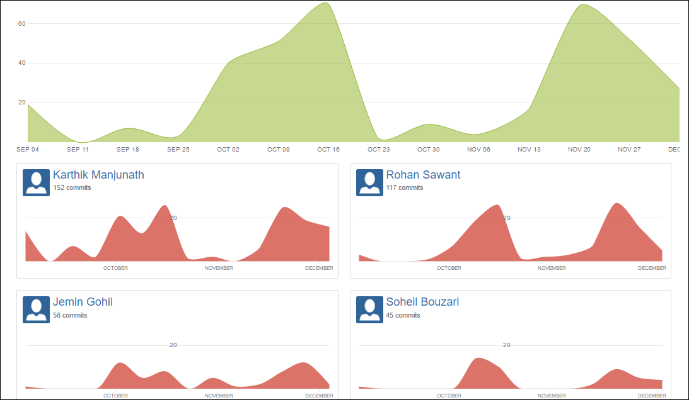
Most of the work done at the end, but got to a stable point till Dec 4. We were done pretty early this time. 80% work in 20% time again. ☺
4
Automated Tools: Version Control

Slide 29
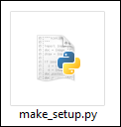
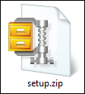
4
Automated Tools
We have Version Control in place and an Automatic Testing in place as well. We just needed a build process in place.
We found some:
a. py2exe
b. PyInstaller
Solution: We made our own installer program (Written in python)
But they packaged certain type of files. But we had many different files to be packaged which was not possible.

Slide 30
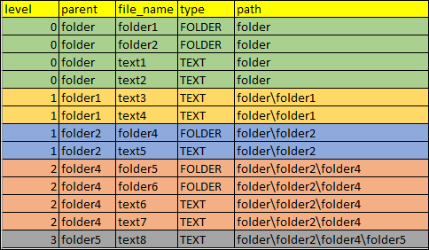
4
Automated Tools – (make_setup.py)
Make_setup.py parses all files & folders along recursion to create the dependencies of files & folders. Which is then used to make the setup files
Notes:
We don’t know till what level our folder structure reaches i.e. a folder which doesn’t have folder inside it like a tree. So we used recursion which gives us all the folder structure that you see here

Slide 31
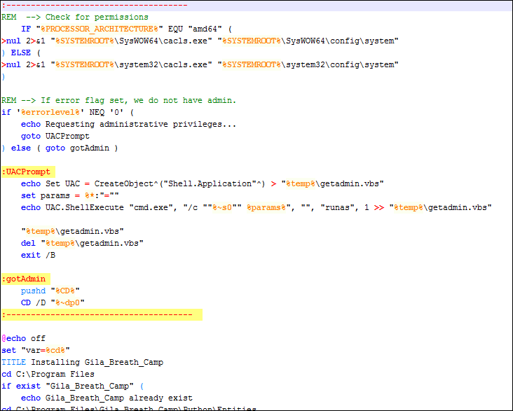
4
Automated Tools – (make_setup.py)
The batch file setup looks something like this
Creates our application in “Program Files” as we see in standard application.

Slide 32
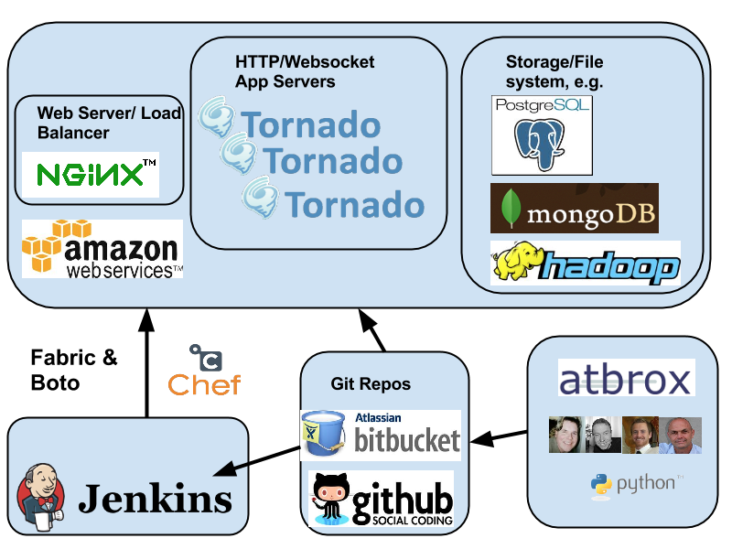
4
Automated Tools – (Continuous Integration)
WHY WE NEED?
Now we needed a Continuous Integration tool like Jenkins
But for using Jenkins we need a server where we get Django environment which may require cost
If we make our local laptop as server than that laptop needs to be on all time to run the test which wasn’t possible
Solution: We made our own CI tool

Slide 33
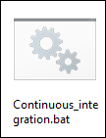
4
Automated Tools – (Continuous Integration)
HOW WE DID?
If all test are SUCCESSFUL then it pushes the code and runs the make_setup.py
By maintaining this flow we can ensure that only tested code is pushed into our Bitbucket repository

Slide 34
5
Demo
Lets got to UI and check it out

Slide 35


Slide 36
REFERENCES
http://www.thehealthcarepeople.com/2015/02/16/top-three-challenges-healthcare-professionals-physicians/
https://docs.python.org/2/library/unittest.html
https://www.djangoproject.com/
https://docs.python.org/2/howto/webservers.html
http://stackoverflow.com/questions/5788521/reading-a-csv-file-using-python
https://guides.github.com/activities/hello-world/
http://lifehacker.com/5983680/how-the-heck-do-i-use-github
https://www.python.org/about/success/

